Slide 1

NEELKANTH INSTITUTE OF TECHNOLOGY
Dr. A.P.J. Abdul Kalam Technology University
JUNE , 2022

Slide 2
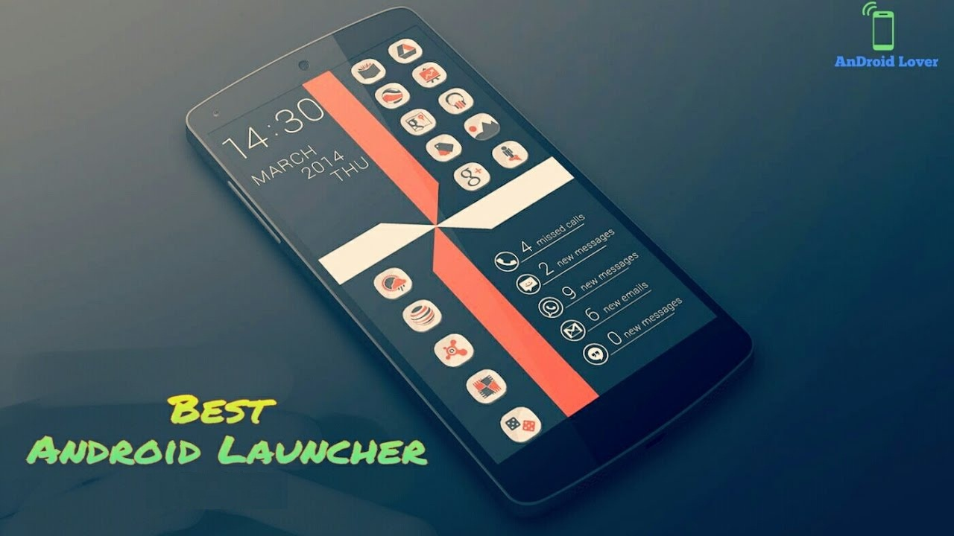
PROJECT ON “ANDROID HOME LAUNCHER”
BY
NITISH KUMAR (1837310033)

Slide 3

CONTENT:-
acknowledgement
ABSTRACT
INTRODUCTION
Project ANALYSIS
PROGRAMMING LANGUAGE
Sample Use
IMPLEMENTATION OF PROGRAM
RECOMMENDATIONS
Conclusion
feedback & suggestion

Slide 4

ACKNOWLEDGEMENT
Source :ANDROID HOME LAUNCHER
HOD SIR:-PROF. PRABHAT GUPTA SIR
Advisor:-PROF. PRABHAT GUPTA SIR
Speaker:- nitISH kumar

Slide 5
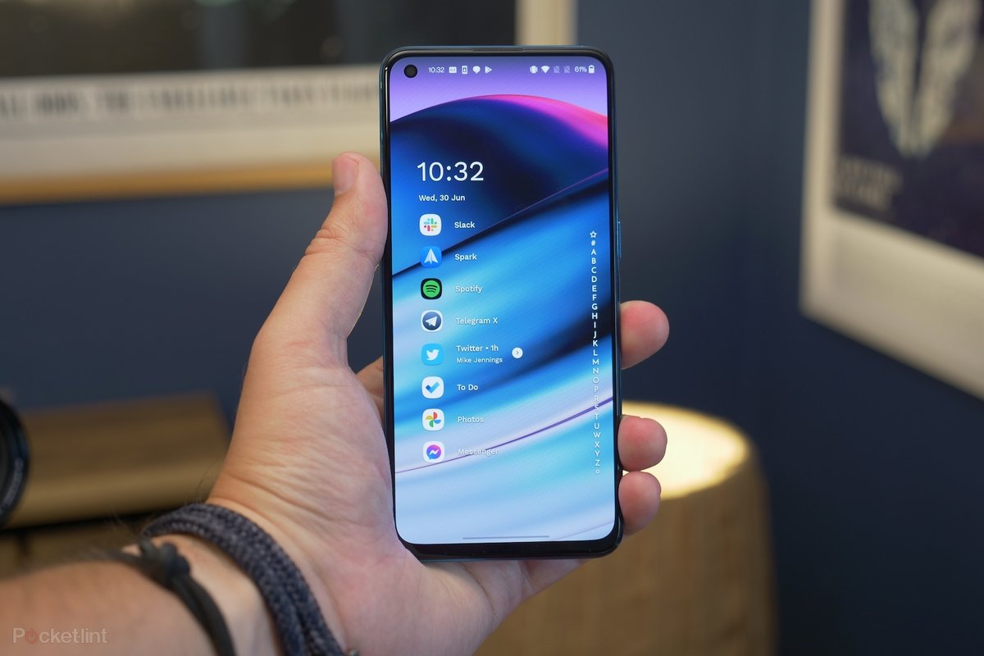
Best light & fast android launcher

Slide 6
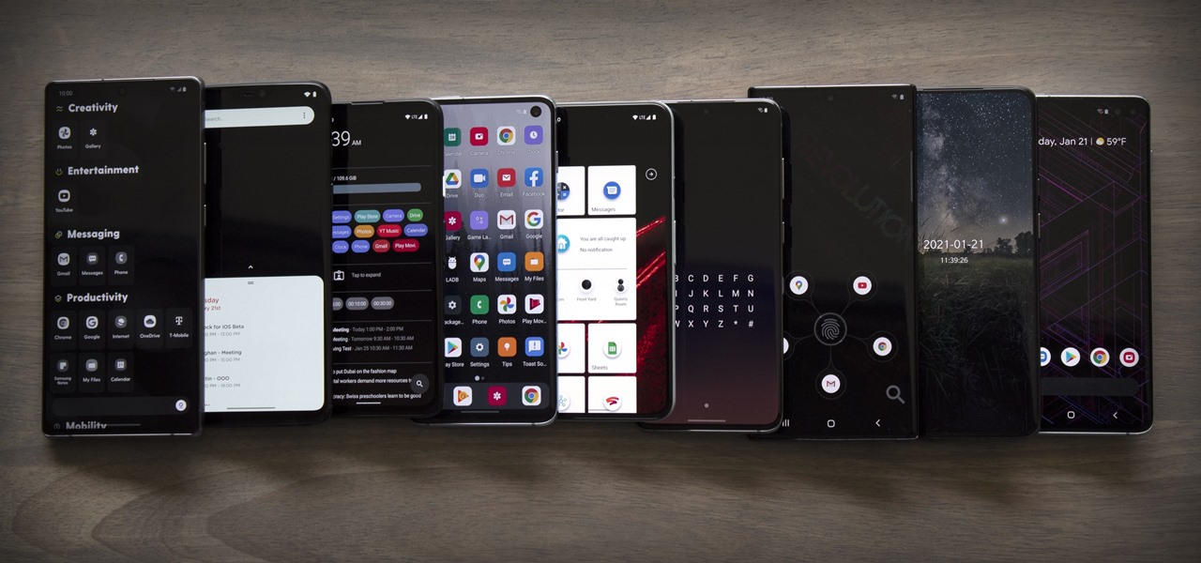
ABSTRACT
ANDROID LAUNCHERS ARE APPS THAT CAN SPICE UP YOUR PHONE'S HOME SCREEN OR ACT AS A PERSONAL ASSISTANT. ALL YOU NEED IS A LAUNCHER, ALSO CALLED A HOME-SCREEN REPLACEMENT, WHICH IS AN APP THAT MODIFIES THE SOFTWARE DESIGN AND FEATURES OF YOUR PHONE'S OPERATING SYSTEM WITHOUT MAKING ANY PERMANENT CHANGES.

Slide 7
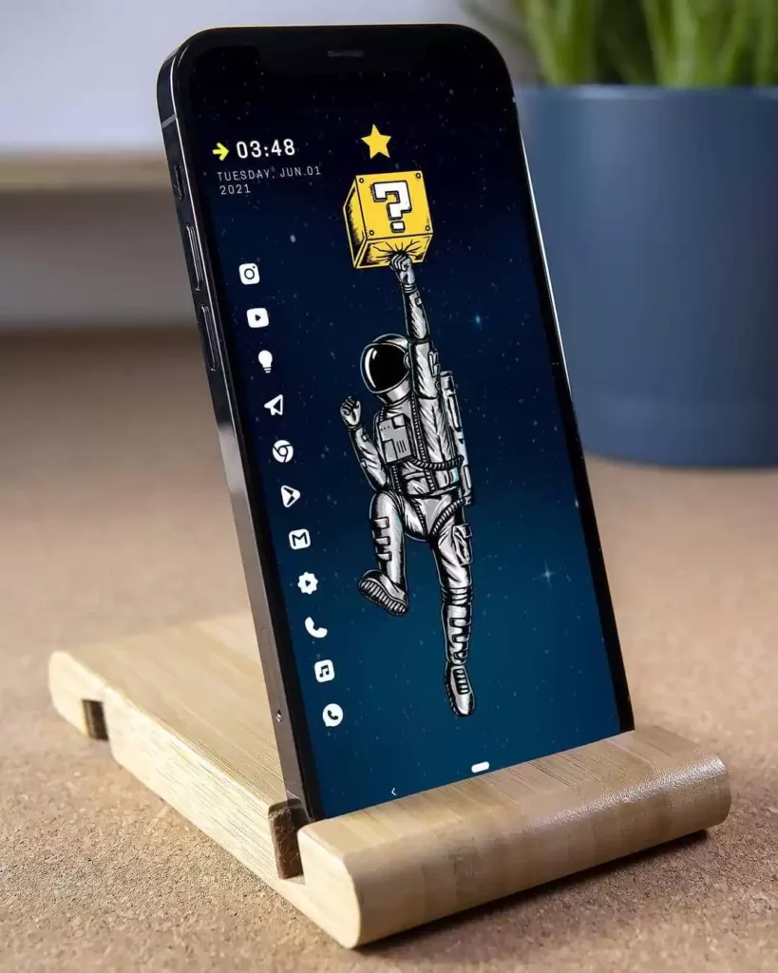
INTRODUCTION:-
One of Android's best features is that you can design your phone's interface. Unlike the iPhone, where Apple dictates how iOS looks and feels, you can personalize your Android home screen or app drawer with almost no effort. All you need is a launcher, also called a home-screen replacement, which is an app that modifies the software design and features of your phone's operating system without making any permanent changes
.

Slide 8


Programming Languages
JavaScript is the primary programming language used for writing the scripts to control the behaviours of objects in this game.

Slide 9
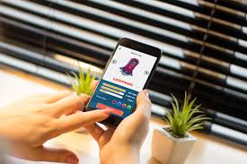
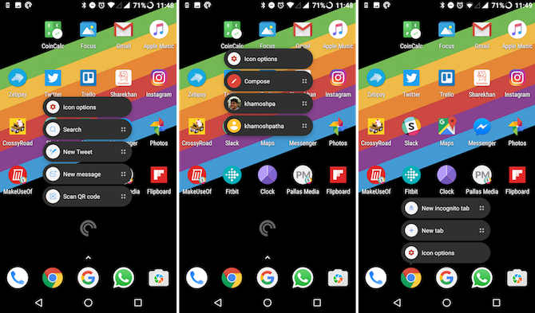
.Project Analysis
The android project contains different type of app modules

Slide 10

ANDROID LAUNCHER DESIGN & IT’S FRAMEWORK
The highly customizable, performance driven, home screen. This Launcher is the top launcher for modern Android, embracing full Material Design throughout. This replaces your home screen with one you control and can customize. Change icons, layouts, animations and more.
.

Slide 11

Launcher Mechanics:
In its most basic form, a launcher is an application that does the following:
it represents the home screen of a device
it lists and launches applications that are installed on the device
In other words, it is the application that shows up when you press the home button. Unless you've already installed a custom launcher, you are currently using the default launcher that comes with your Android installation

Slide 12
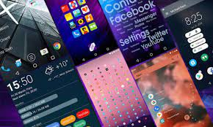
The overall design of ANDROID LAUNCHER
Build and run your application once more to see the result. You should now be able to see the applications that can be launched when you click the button on the home screen of our launcher. Click on an item to launch the corresponding application.

Slide 13

. Recommendations
Suggested Team: Myself. I will be doing all the parts of the project.
Estimated Budget: As of right now, there’s not going to be any spending because all the software I’m going to be using are free to student and is easily accessible.
Rough Timeline: 2 month period
Coding & testing ~ 1 month.

Slide 14

Conclusion
Android project as having "tremendous potential in developing smarter mobile devices that are more aware of its owner's location

Slide 15

Created by ni30tians Thanks for visiting my code”ANDROID HOME LAUNCHER” which is Pure JavaScript //Version 1.0.0 If you have any feedback or Suggestion...Please comment...
Any feedback & suggestion

Slide 16
THANK YOU….

